Slide 1
Biodiversity loss
By: Mitin P. A., ИУ6-14Б
Supervisor: Lipatova O. V.
BMSTU, 2022

Slide 2
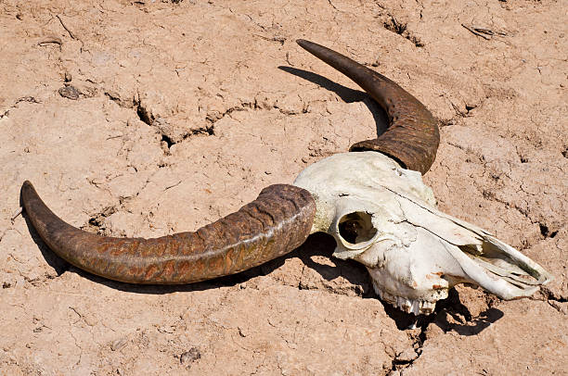
Definition
Biodiversity loss describes the decline in the number,
genetic variability, and variety of species, and the biological communities
in a given area.

Slide 3
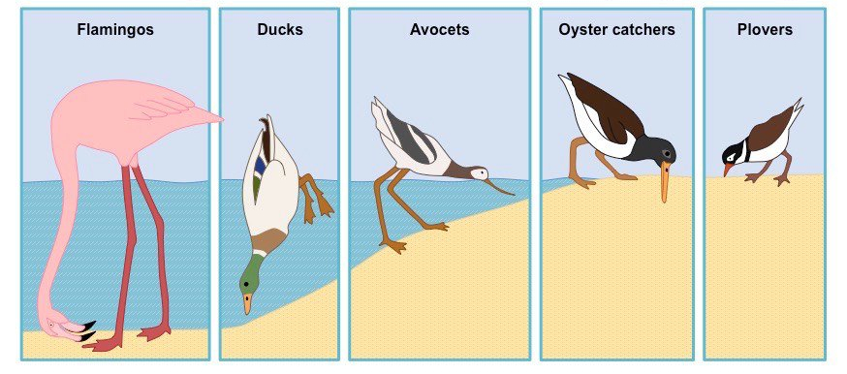
Effects and consequences: ecological niches
Even though a species is not eliminated from the ecosystem or from the biosphere, its niche (the role the species play in the ecosystems it inhabits) diminishes as its numbers fall. For example, clearing trees from a forest eliminates the shading, temperature and moisture regulation, animal habitat, and nutrient transport services they provide to the ecosystem.

Slide 4
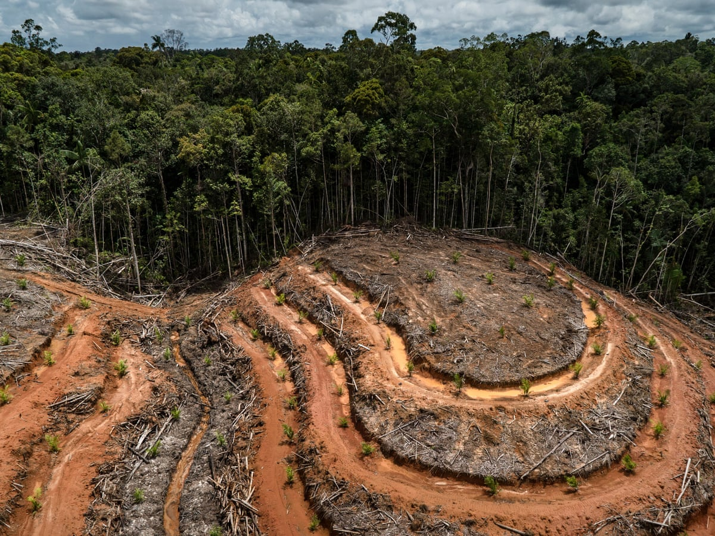
Human-driven biodiversity loss
Human-driven causes of biodiversity loss
Habit loss and degradation
Invasive species
Overexploitation
Pollution
Climate change (global warming)

Slide 5
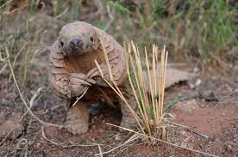
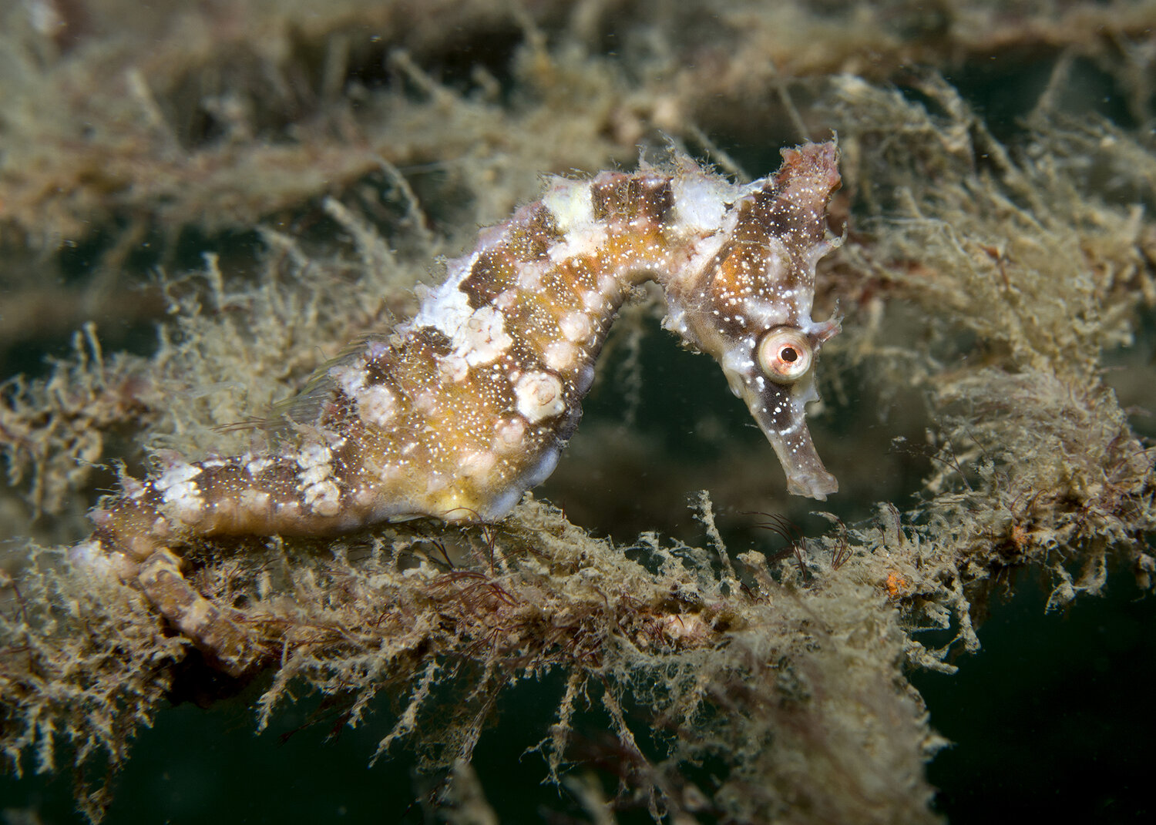
Examples
Pangolin – almost extinct
due to illegal wildlife trade
Seahorse – population in Asia
decreased by almost 50%

Slide 6
Thank you for your attention!

